Slide 1
Unit V
The Interwar Years:
Revolution and Nationalism
1919-1939
Part 3

Slide 2
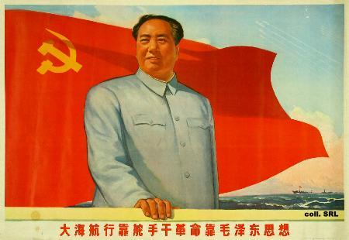
The Collapse of Imperial China
Leads to Revolution and Civil War
1900-1949

Slide 3
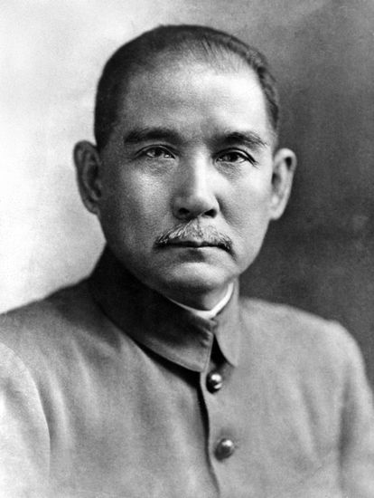
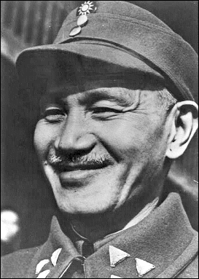
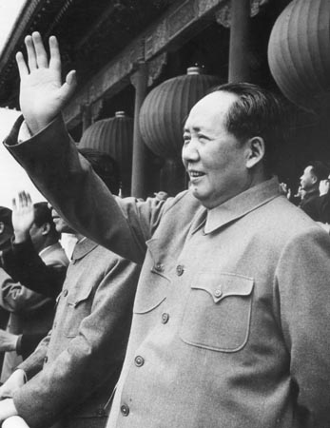
Who’s Who in China’s Civil War and Revolution (And How to Pronounce Their Names)
Kuomintang
=
Nationalists
Sun Yixian
(Soon yee shyahn)
Formerly
Sun Yat-sen
Jiang Jieshi
(Jee-ahng jee-shee)
Formerly
Chiang Kai-shek
Mao Zedong
(MOW Dzuh-dahng)
Formerly
Mao Tse Tung
Leader of Kuomintang
(Kwoh Mihn TANG)
Leader of Nationalists
Leader of Communists

Slide 4
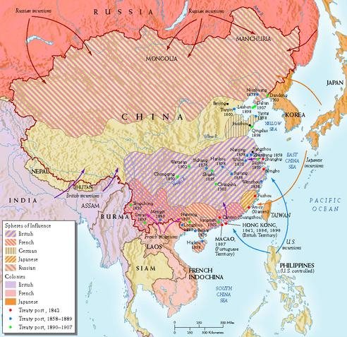
Early 1900s China Ripe for Revolution
China’s trade and resources
controlled by foreigners.
Chinese nationalists pressed
for modernization and wanted
to end humiliation of foreign
control.
Most prominent nationalist
group was the Kuomintang
or Nationalist Party.

Slide 5
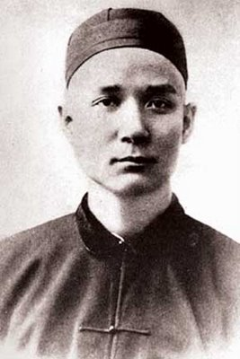
1912 Qing Dynasty Overthrown
The Kuomintang overthrew the Qing
dynasty, which had ruled China since
1644, and established a republic.
Kuomintang were led by Sun Yixian.
Sun wanted a modern government based
on “three principles of the people”:
Nationalism (end of foreign control).
People’s rights (democracy).
People’s livelihood (Economic security
for all).
Sun Yixian
(Soon yee shyahn)
“Father of Modern
China”

Slide 6
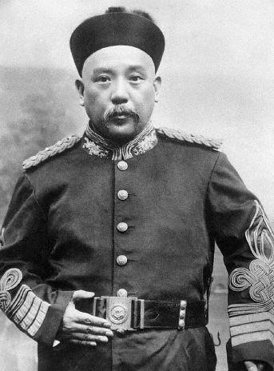
1916 Civil War Breaks Out
Sun gave up power after only six
weeks. Did not have the support
of the military and couldn’t
unify the country.
General Yuan Shikai succeeded
Sun and ruled as military dictator.
Local revolts against Yuan’s rule.
Civil war broke out after Yuan’s
death in 1916.
Local warlords divided up China
as their armies terrorized the
countryside. Peasants suffered.
General Yuan Shikai
(yoo-ahyn shee-ky)

Slide 7
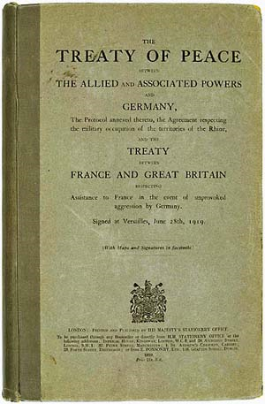
WW I Breeds Disillusionment in China
China joined war against Germany,
mistakenly believing that grateful
Allies would return control of China
to the Chinese.
Allies gave Germany’s Asian colonies
to Japan, not China, after the war.
Led to widespread protests against
Treaty of Versailles and European
imperialists.

Slide 8
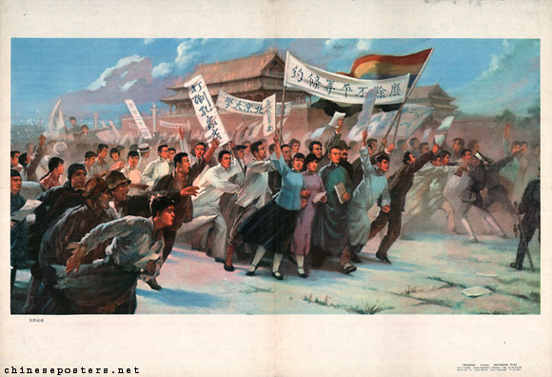
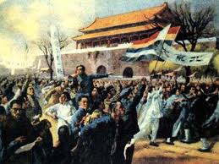
1919 The May 4th Movement
Student outrage over China’s
treatment under Treaty of
Versailles led to widespread
protests.
Many young Chinese turned
against Western democracy.
and embraced communism
as a better model for social
and economic change.

Slide 9
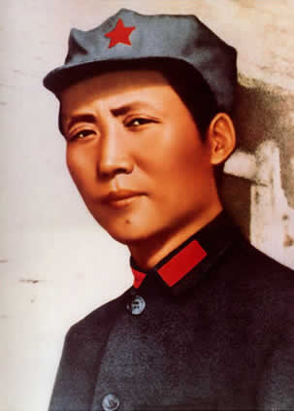
1921 The Communist Party Formed in China
China’s Communist Party formed
in 1921. Mao Zedong was one
of its founders.
Western democracies refusal to aid
Sun Yixian, which led him to seek
Soviet support and ally with China’s
communists.
Lenin sent military aid and advisors
in return for what?
Chinese communists being allowed to
join Kuomintang .

Slide 10
Nationalists Turn on Communists
Sun died in 1925. Chiang Kai-shek
(Jiang Jieshi) became leader of Nationalists.
Jiang waged successful war against warlords (“Northern Expedition”)
Jiang and his capitalist supporters opposed communism.
Jiang set out to purge Kuomintang of the Communists.
Generalisimo
Jiang Jieshi
(Chiang Kai-shek)

Slide 11
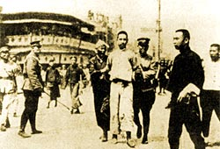
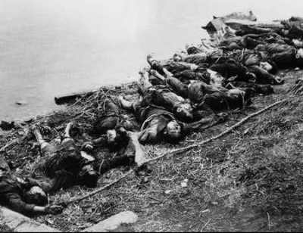
1927 The Shanghai Massacre
Large-scale purge of Communists
from the Kuomintang in Shanghai,
ordered by Jiang.
Arrests and executions of prominent
Communists / union leaders spread
across China.
Thousands were killed. Communist
Party almost wiped out.
The few Communist survivors (Mao Zedong included) went into hiding.

Slide 12
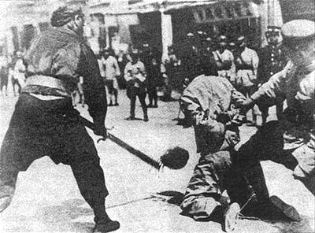
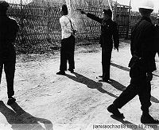
1927 The Shanghai Massacre
Executions of Communists by Nationalist forces,
Shanghai 1927

Slide 13
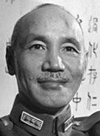
1928 Nationalists Gain Control But Lose Support
Jiang Jieshi became president of
“Nationalist Republic of China.”
Nationalist government recognized by Britain and U.S., but not Russians.
Nationalist government corrupt and
undemocratic.
Modernized cities but did nothing to
help China’s peasants.
Peasants supported communists,
who gave them land.
Jiang Jieshi

Slide 14
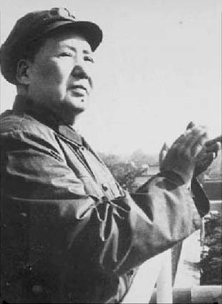
1930 Civil War: Communists vs. Nationalists
Full-fledged civil war between
Communists and Nationalists
by 1930.
Communists led by Mao Zedong
Based in the countryside.
Recruited peasants for Red Army.
Trained them in guerilla warfare.
Attacked Nationalist forces from
Mountain hideouts.
Mao Zedong

Slide 15
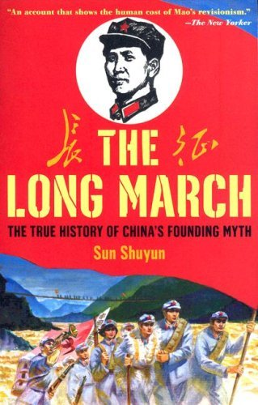
1934-1935 The “Long March”
Communist forces surrounded by
700,000 Nationalist troops.
87,000 Communists escaped and
fled on the hazardous 6,000 mile
“Long March.”
Crossed 24 rivers and 18 mountain
ranges in year-long flight from
pursuing Nationalist forces.
95 percent of Red Army was lost.
Only 6,000-7,000 survived.

Slide 16
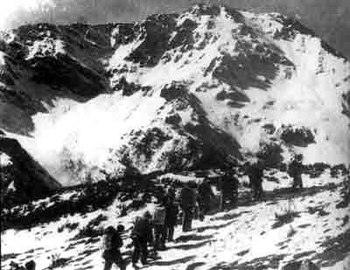

Slide 17
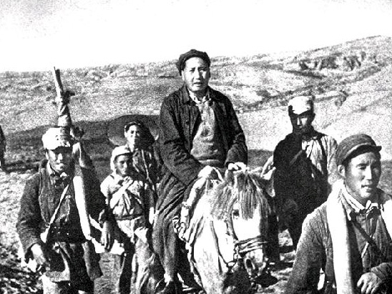
Mao Zedong on the Long March

Slide 18
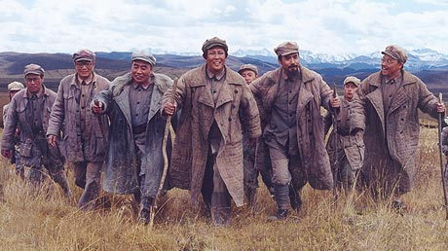
The Long March increased the Communist’s loyalty to
Mao and became China’s founding myth.

Slide 19
The Long March

Slide 20
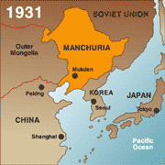
1931 Japan’s Invasion of Manchuria
Japan invaded Manchuria in
1931. Nationalist response?
Nationalists didn’t resist. Hoped
policy of non-resistance would
dissuade Japan from attacking
all of China.
Chiang Kai-shek also believed it
was more important to defeat the
Communists than fight Japan.
Not all Nationalists agreed.

Slide 21
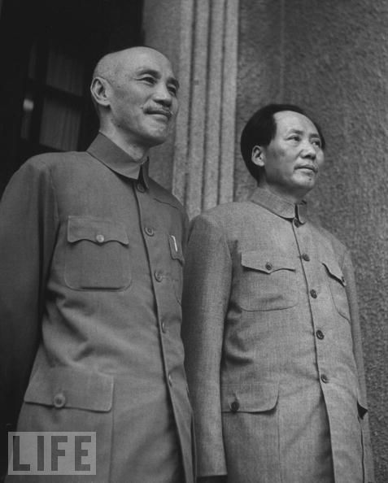
1937 Japan Invades China. WWII Begins
Japan launched all-out invasion
and bombing of China in 1937.
Impact on China’s civil war?
Threat from Japan forced uneasy
truce between Nationalists and
Communists, who temporarily
united to fight the Japanese.
What happened after WWII
ended ?
Civil War resumed after Japan’s
defeat in 1945.

Slide 22
Nationalists vs. Communists
Characteristics | Nationalists | Communists
Leader | Chiang Kai-shek | Mao Zedong
Occupied territory | Ruled in the South of China after WWII | Ruled in the North after WWII
Support | United States | Soviet Union
Government strengths and weaknesses | Struggled with inflation and a failing economy | Promise of land reform appealed to peasants
Military | Suffered from weak leadership and poor morale | Experienced guerrilla army that was highly motivated
Based on this information, explain why the Communists eventually won the civil war in China.

Slide 23
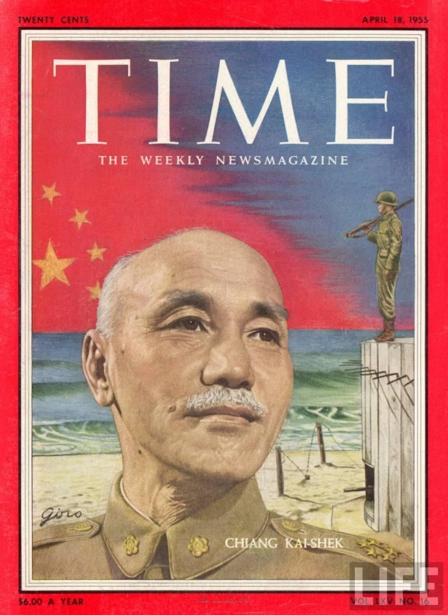
U.S. Support for Nationalists
China’s nationalist government
a U.S. ally in World War II.
Dictatorial, corrupt, incompetent
government.
Lacked support of Chinese people.
U.S. supported Jiang Jieshi because
he was anti-communist.
Received billions in U.S. aid.
Jiang Jieshi
(Chiang Kai-shek)

Slide 24
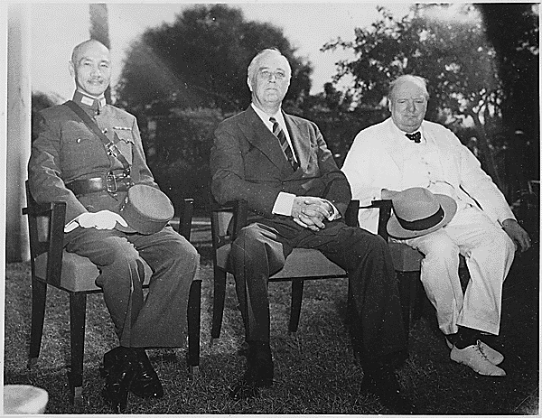
Chiang Kai-shek, FDR, and Churchill During WWII

Slide 25
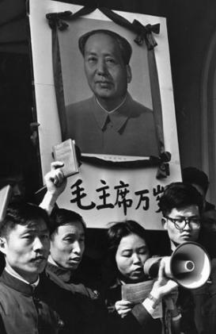
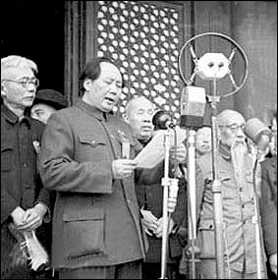
1949 Mao Proclaiming People’s Republic of China After Communist Victory
China in Revolution Part 10/10

Slide 26
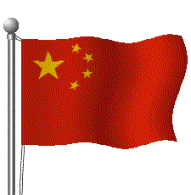
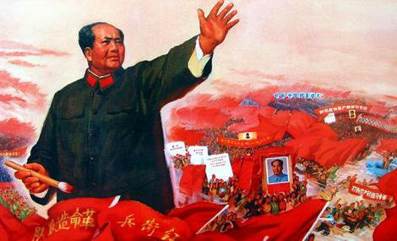
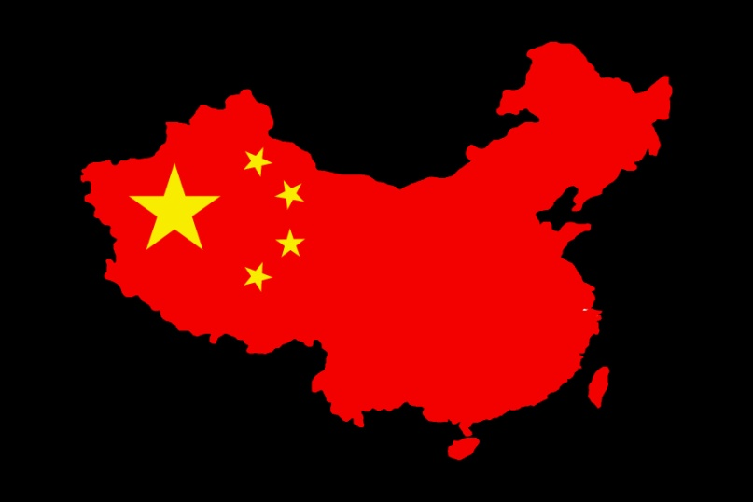
1949 Establishment of Communist China
Mao established communist
government on the mainland –
“The People’s Republic of
China.”
U.S., other Western powers
refused to recognize the new
government of country we
called “Red China”
Mao signed friendship treaty
with Soviet Union
.

Slide 27
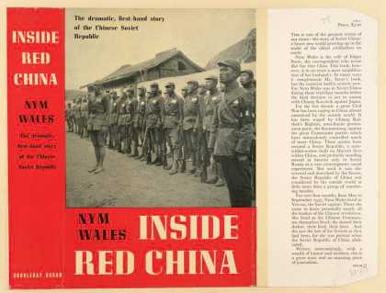
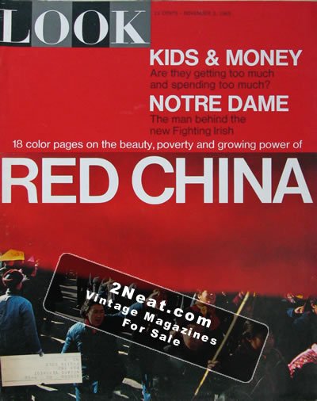
“Red China”

Slide 28
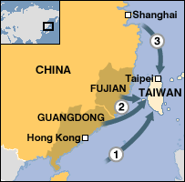
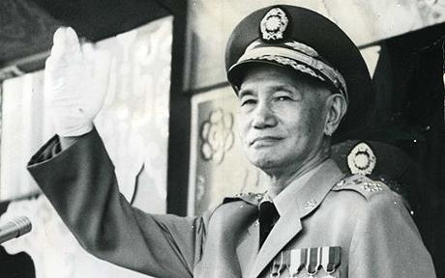
1949 Nationalist’s Flee
Nationalists fled to island of
Formosa (Taiwan) and set
up independent government
there.
Nationalist China was
recognized by U.S. and other
Western powers (including
the U.N.)

